Slide 1
Module 33: Introducing Enterprise Integration Manager
Siebel Core Developer and Technology School
Notes:
Time: Lecture: 15 minutes; no lab
Intent: To introduce Enterprise Integration Manager (EIM) and why organizations need to use it. Now that the students have a broad understanding of the various integration tools and strategies, this and the next several modules focus on EIM. As this course primarily focuses on Phase One implementations, EIM will probably be a critical tool for performing bulk imports, exports, updates, and deletes.
Flow: User data, base tables, and how user data can be managed in them; user keys, interface tables, Enterprise Integration Manager and its processing; how EIM uses user keys to maintain referential integrity; and how SQL statements defeat referential integrity when used to import into a Siebel database.
Key Terms:
Base tables
User keys
Interface tables (EIM tables)
Referential integrity
Row ID
Please note: Faculty-specific notes are italicized.

Slide 2

Module Objectives
After completing this module you will be able to:
  Describe how Enterprise Integration Manager (EIM) supports Siebel referential integrity while importing external data
  Describe why direct SQL statements cannot be used to insert user data
Why you need to know:
  Enables you to properly import external data into the Siebel database

Slide 3
User Data
User data is populated and managed by you
  Installation populates seed data and repository data, not user data
Database
User-supplied data such as account information
Notes:
Seed data is populated when the database is installed using the DB Server Configuration wizard. Repository data is populated with the DB Server Configuration utility’s Import/Export Repository option. User data must be populated by the user. More information in next slide.

Slide 4
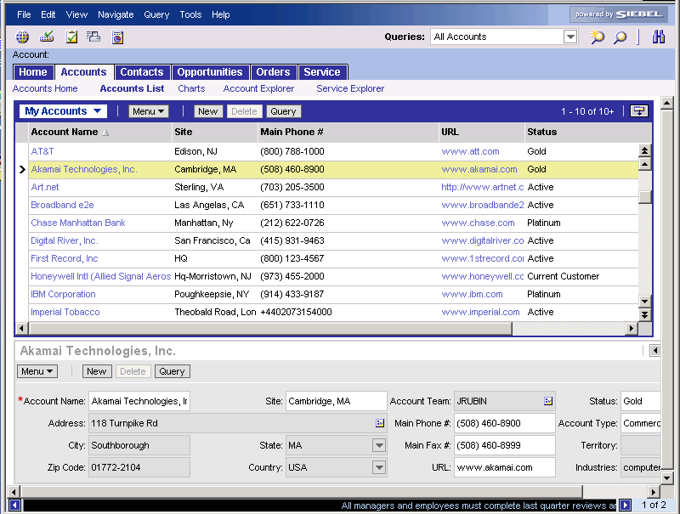
Populating and Managing User Data
Use the client application to enter, update, or delete small amounts of data directly in the base tables
Use server tasks to:
  Import large amounts of data from external sources through interface tables
  Delete large amounts of data
Database
External data
Interface table
Server task
Base table
Notes:
This slide introduces base and interface tables. They will be defined on subsequent slides. You can populate user data in one of two ways. If it is a small amount of data, you can enter it through the application UI to populate data in base tables. Students have gotten practice so far using this approach. The second approach is used for large amounts of data. One can use a server component to bring in data from external sources through interface tables, which then will move the data to base tables.

Slide 5
Base Tables
User data is stored in one or more base tables in the Siebel database
  Relationships between base tables (referential integrity) rely upon primary and foreign keys based on ROW_IDs
    ROW_ID is the system primary key for every base table
    ROW_ID is a system-generated value
PK
PK
FK
FK
FK
S_BU
S_ORG_EXT
S_ADDR_ORG
Notes:
While you may not want to go into great depth on the subject of normalization, it should be stated that this principle is not unique to Siebel applications. Any implementation based on a RDBMS will use this technique. Normalization is a set of techniques for organizing data in tables in a manner that eliminates redundancy and incompleteness.
What is unique to Siebel applications is the use of ROW_ID. Any database can generate a row ID. However, the ROW_ID described here is specific to Siebel applications and is used to maintain referential integrity. Referential integrity ensures that for each foreign key value, there is a matching primary key value. Students have had practice looking at foreign key and primary key columns prior to this point in the course.
The main point here is that the system’s primary and foreign keys are managed by the Siebel application.

Slide 6
User Keys
Based on multiple columns, user keys are used to uniquely identify a row for EIM
Primary and foreign keys based on ROW_ID are used for system-wide referential integrity
PK
User Key
FK
ROW_ID
NAME
LOC
BU_ID
S_ORG_EXT
S_BU
Notes:
This slide defines user keys and compares them with ROW_IDs. User keys are used to prevent duplication of records. ROW_IDs are used to maintain system-wide referential integrity. Later in the module, you will present how user keys are used by EIM to resolve ROW_IDs, maintaining referential integrity.

Slide 7
Interface Tables
Interface tables store external data inside the Siebel database
  Staging area for data to be imported, updated, or merged into base tables via EIM
  Staging area for data exported by EIM
  Staging area for data to be deleted in the base table using EIM’s DELETE EXACT clause
EIM_ACCOUNT
S_ORG_EXT
S_ADDR_ORG
Interface Table
External data
Base Tables
Notes:
Note with Siebel 7.7 interface tables are now called EIM tables.
It is important to point out that interface tables (or EIM tables) are tables inside the Siebel database. They are part of the initial schema. Interface tables tend to be denormalized, meaning that the tables contain multiple columns and are not designed for efficiency in relationships. These tables usually represent all of the data for a given entity (many base tables). For example, the EIM_ACCOUNT table contains columns for S_ORG_EXT, S_ADDR_ORG, and other base (normalized) tables.
Notice that external data may be in the form of other non-Siebel databases or flat files.
For more information about data cleansing, refer to Bookshelf. The important point here is that EIM does not fix inaccurate or inconsistent data.

Slide 8
Enterprise Integration Manager (EIM)
Server task that manages the exchange of data between external data in interface tables and user data in base tables
S_ORG_EXT
EIM_ACCOUNT
EIM
Siebel
Server
S_ADDR_ORG
External data
Notes:
Use the graphic to explain that Siebel EIM manages the bidirectional exchange of data between the Siebel databases and other corporate databases. This exchange of information is accomplished through intermediary tables called EIM tables (these tables were previously known as interface tables). The interface/EIM tables act as a staging area between the Siebel application database and other databases. Customers should use EIM to perform bulk imports, exports, updates, and deletes.

Slide 9
EIM Processing
EIM reads a configuration file to determine:
  Whether data should be imported, merged, deleted, or exported
  Which interface table(s) and base table(s) are used and affected
Import, merge, delete, or export
EIM
Siebel
Server
Configuration file (.ifb)
Notes:
The configuration file (.ifb) for EIM is not the same configuration file (.cfg) that is used by the client applications. Notice that the focus of the labs and of the class will be on IMPORT and DELETE. There will be an opportunity to practice with EXPORT during the migration labs.

Slide 10
Referential Integrity
User key column mappings in interface tables are used to resolve ROW_IDs for base tables, maintaining referential integrity
PK (ROW_ID)
User key
1-8D
Acme
FK (ROW_ID)
Interface Table
1-8D
Base Tables
Notes:
The point here is that EIM uses user key data to figure out what the proper PK and FK ROW_IDs should be. Notice that Acme is in the interface table and it gets translated so that the proper rows in the base tables are accessed and processed. The user key identifies the row on the EIM table. The ROW_ID on base tables identifies relationships between tables. EIM is smart enough to generate and look up appropriate ROW_IDs during its processing. Therefore, it maintains the referential integrity of the database.

Slide 11

SQL
You cannot use SQL to populate user data in base tables
  Relationships between tables are complex
  Referential integrity is maintained programmatically through ROW_IDs, not using constraints on the database
  SQL statements cannot generate Siebel ROW_IDs
PK
SQL
FK
S_ORG_EXT
S_ADDR_ORG
Notes:
Since the Siebel ROW_IDs used for referential integrity are generated by Siebel programs, one must use Siebel programs to insert, update, and delete rows from tables. Siebel ROW_IDs cannot be generated using SQL and, therefore, running direct SQL insert, update, and delete statements against base tables will corrupt the referential integrity in the database. Students will see later that it is OK to run SQL against EIM tables.

Slide 12
Summary
This module showed you how to:
  Describe how Enterprise Integration Manager (EIM) supports Siebel referential integrity while importing external data
  Describe why direct SQL statements cannot be used to insert user data
Notes:
Review Question: What role does the user key play in maintaining referential integrity?
Review Question: Why is it a bad idea to use SQL to directly update Siebel base tables?
True or false: EIM is a server process used only for imports and deletes of large amounts of data.

